Slide 1


UK Embedded Solar Generation
An analysis and predictions of UK Embedded Solar Generation By Grid Supply Point (GSP)

Slide 2
Presentation Overview
Contents
Section 1 | The Problem – overview of UK electricity networks
Section 2 | The Solution – our data analysis and model overview
Section 3 | Exploring the data – single GSP case study
Section 4 | Conclusions and next steps

Slide 3

1.0 The National Energy System Operator (NESO)
The National Energy System Operator (NESO) is the independent public body responsible for keeping the lights on in Great Britain.
NESO’ core job is to match supply and demand on the national electricity grid, second by second, to keep the frequency at 50 Hz to avoid blackouts caused by over or under supply.
To facilitate this, throughout the day, NESO issues instructions on the Balancing Mechanism (BM) to large-scale generators and consumers, e.g, “increase output by 50 MW,” “decrease by 100 MW.”

Slide 4

1.2 The Balancing Mechnism (BM)
The BM is the real time control room for NESO’s balancing instructions, which are shared publicly.
Most energy trading happens in the day-ahead market, where participants buy and sell power for delivery tomorrow. But the day-ahead is based on forecasts—and forecasts are never perfect. The Balancing Mechanism handles reality: when wind drops unexpectedly or a plant trips offline, NESO buys or sells power in real time to keep frequency at 50 Hz.
The increasing volume of generators connected to the Distribution Network makes NESO’s activities increasingly more challenging and essential to have accurate data sources and prediction

Slide 5
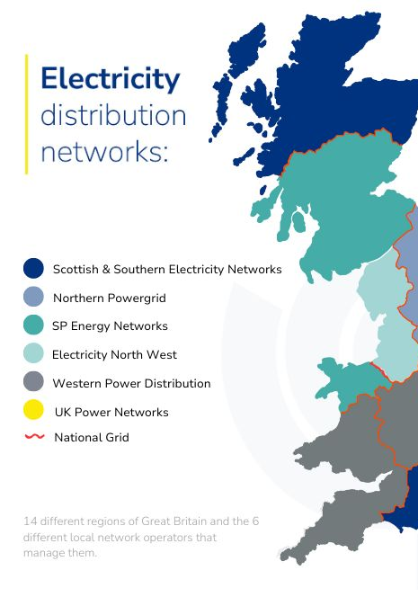
1.3 Electricity Distribution Networks
The Root of the Problem:
The UK national electricity grid network was originally designed in the 1950s for transporting electricity from traditional large scale base-load turbine generators connected to the transmission network (132kV and above) which subsequently supply the distribution network (132kV and below) to then feed our homes and businesses.
Solar and battery power plants tend to be much smaller than traditional turbines meaning they are connected at lower voltages directly to the distribution networks (132kV and below – i.e., embedded Generation):
This means electricity can now flow upward—from a solar array back into the distribution network, and onto the transmission grid. Which complicates NESO’s balancing because;
the system operator must now coordinate not just a few hundred large generators but potentially millions of small distributed sources, and crucially, NESO cannot directly see most behind-the-meter (embedded) generation, making demand forecasting significantly harder.

Slide 6
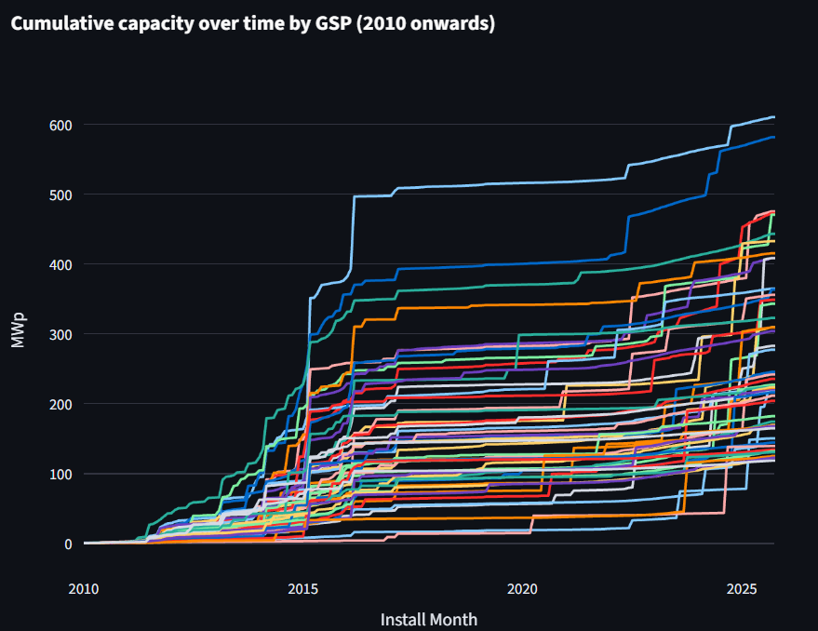
1.4 GSP Embedded Solar Capacity
UK Embedded Solar Capacity Over Time:
Significant growth of solar capacity over the past 15 years was driven initially by the Feed-in-Tariff (FiT) subsidy scheme from 2010 to 2015 with later growth marked by the reducing cost of building and maintaining solar, making it now one of the cheapest forms of producing electricity.
The latest challenge faced by the industry is now caused by an over-congested UK electricity grid network. Particularly for larger installations which are struggling to find capacity on the network.

Slide 7
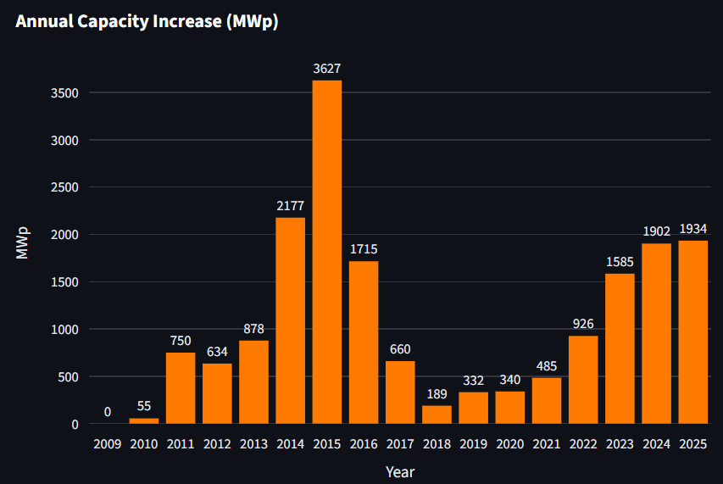
1.5 GSP Embedded Solar Capacity
Bar Graph Showing New Installed Solar Capacity by Year:
Major capacity gains were initially seen in 2011 following the launch of the FiT scheme in 2010 with a slight reduction in 2012 caused by reducing FiT support rates.
Further growth to 2015 is seen as economies of scale drove down manufacturing costs granting viability for larger projects supported by the Renewable Obligation Certification (ROC). ROCs, however, were subsequently restricted to only new solar projects below 5MW in 2015, hecne the 2016 downward trend.
From 2020 onwards capacity growth is purely subsidy-free given the complete closure of the FiT and ROC schemes for all new solar in 2019 and 2017, respectively. We note a recent tailing-off of new capacity as the grid becomes more congested.

Slide 8

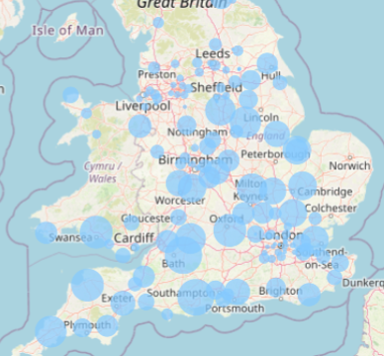
1.6 Grid Supply Points (GSPs)
GSPs are essentially large-scale substations which act as nodes which intersect between the Distribution and Transmission networks, and;
Most UK solar projects are connected downstream of a single GSP.
This includes small scale 4kW home installations and large-scale solar farms of up to hundreds of MWs.
This project aims to predict the solar generation connected downstream of 289 GSPs across the country.
Notes:
Image source: Microsoft 365 content library
Highlighting important numbers offers a quick snapshot of performance or growth. Core categories group information effectively, making analysis and decision-making easier. Together, they provide essential insights, support strategic planning, and allow stakeholders to focus on the most impactful areas of a business or project.

Slide 9
The Question:
Can we extract, clean, visualise, and forecast the embedded solar generation for GSPs in the UK with sufficient accuracy to support NESO’s instructions in the BM?
The purpose is to increase the operating efficiency of the network by reducing redundancy in decision-making and create savings which flow down to UK consumers.

Slide 10

2.0 The Dashboard
289 GSP locations
2 APIs
(solar and weather)
5 years
hourly historical data
5 ML algorithms
trained and tested
6GW Solar capacity

Slide 11
2.1 Data Flow
Train Model
Extract & Clean
Make Prediction
The dashboard connects to two endpoints from the Sheffield Solar PVLive API to extract:
Cumulative solar capacity (MWp), and;
Historic solar generation (MWh).
It then matches GSP IDs to their geo-locations sourced from the:
NESOs website,
and (using the location of the selected GSP) pulls localised historic hourly weather data from:
Open meteo historical weather
then trains, fits and predicts with a machine learning model based on selected solar and weather data profiles.

Slide 12
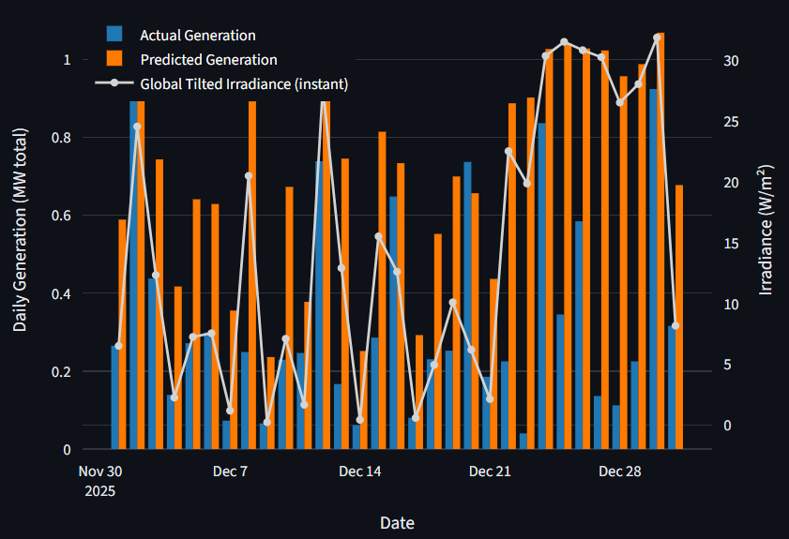
3.0 Case Study – Newton Stewart GSP
Daily Solar Generation vs. Predictions:
The plot to the right shows the variance between actual solar generation and our model's predicted generation. We note predictions tend to track irradiance more closely than actual generation. Reasons for this may include:
predictions are based on a single location (and weather conditions) at the GSP, but the solar plants are scattered in multiple locations around the GSP, and;
generation may have been affected by other factors such as grid and/or localised plant faults.

Slide 13
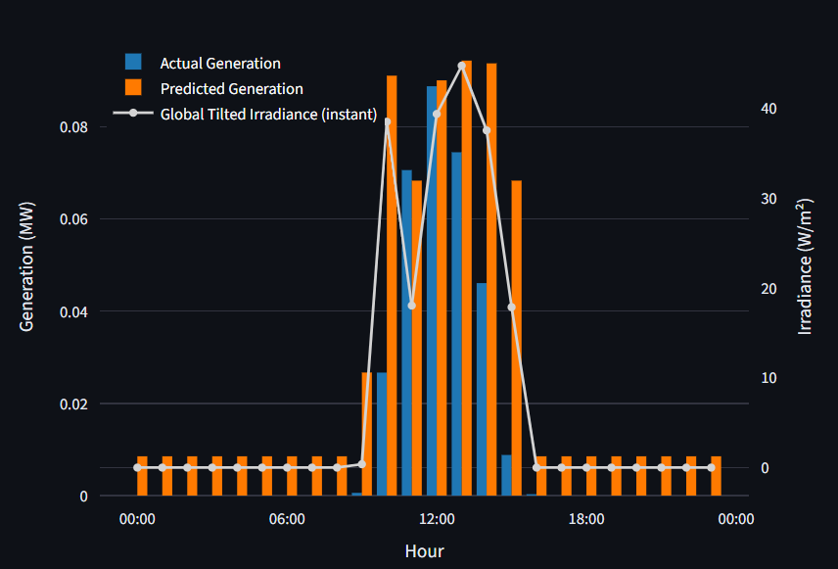
3.1 Case Study – Newton Stewart GSP
This plots highlights required adjustments to improve accuracy in the next iteration of the ML model:
The XGBoost ML model erronesouly predicts some small generation during hours of 0 irradiance, we will adjust to ensure 0 generation during these hours.
The interpolation method extends too far when imputing missing actual generation data, we will reduce the scope of the interpolation and impute remainder of NaNs with 0s.

Slide 14
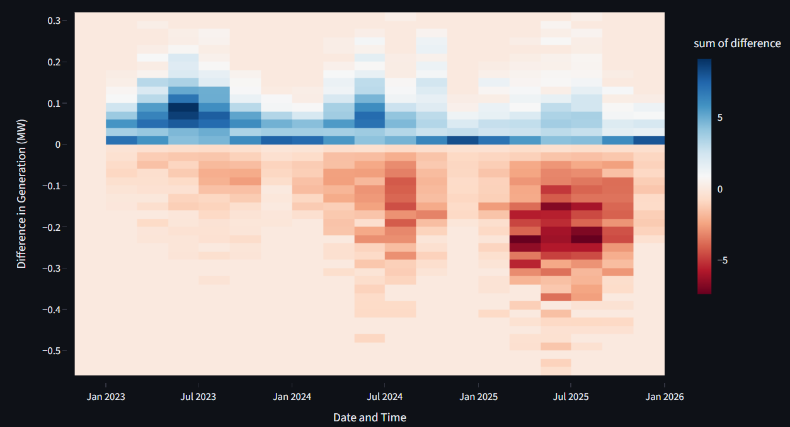
3.2 Case Study – Newton Stewart GSP
Heatmap showing the difference between the actual solar generation vs. predicted over time :
The model becomes more inaccurate over time as solar capacity increases.
Solution: heavily weight the GSPs solar capacity feature in future fine-tuning of the ML model

Slide 15
4.0 Conclusion: further refinement is required to accurately support NESO’s BM actions
Data Cleaning
Interpolate impute fewer missing solar generation values to avoid skewed generation profiles
Impute remaining NaNs in the generation data with zeros
Model Refinement
Tune and re-test the XGBoost ML model to more heavily weight capacity feature and account for increased MWp over time
Retrain model to ensure predictions read zero generation during hours of zero irradiance
Incorporate other weather data parameters such as humidity, wind and temperature
Reach out to the Sheffield Solar API team to understand if unique solar project locations can be sourced

Slide 16

Thank You
samhsforrest@gmail.com

